Slide 1
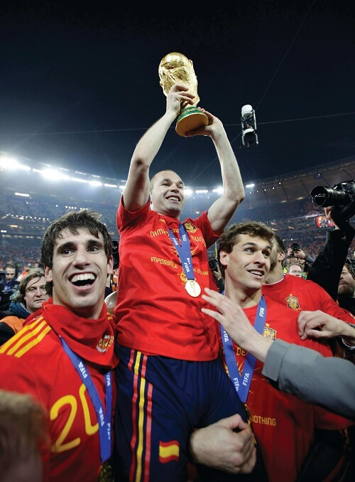


Part I Warm Up
Language Note
Some popular sports include: soccer (or football in British English), baseball, cricket, rugby, basketball, volleyball, hockey, football (or American football in British English), tennis, table tennis, wrestling, martial arts, cycling, running, golf, skiing, swimming, skateboarding, bowling.
Sports
Answer these questions with a partner.
What sport is in the photo? Soccer/Football.
Is this sport popular in your country? Yes. (or No. Then propose a sport which is popular in your country.)
What is your favorite sport? Answers will vary. Some popular sports include: soccer (or football in British English), baseball, cricket, rugby, basketball, volleyball, hockey, football (or American football in British English), tennis, table tennis, wrestling, martial arts, cycling, running, golf, skiing, swimming, skateboarding, bowling.
.
y.)
Content Note
bowling.
The picture shows members of Spain’s national soccer team immediately after winning the FIFA World Cup in 2010 in South Africa. Although Spain’s team had participated in twelve World Cup tournaments since 1930, it wasn’t until their thirteenth tournament in 2010 that they finally won the championship. The win was historic both for Spain and for the European community of soccer players and fans.
Soccer player Andres Iniesta of Spain holds a trophy after his team wins the World Cup.

